Slide 1
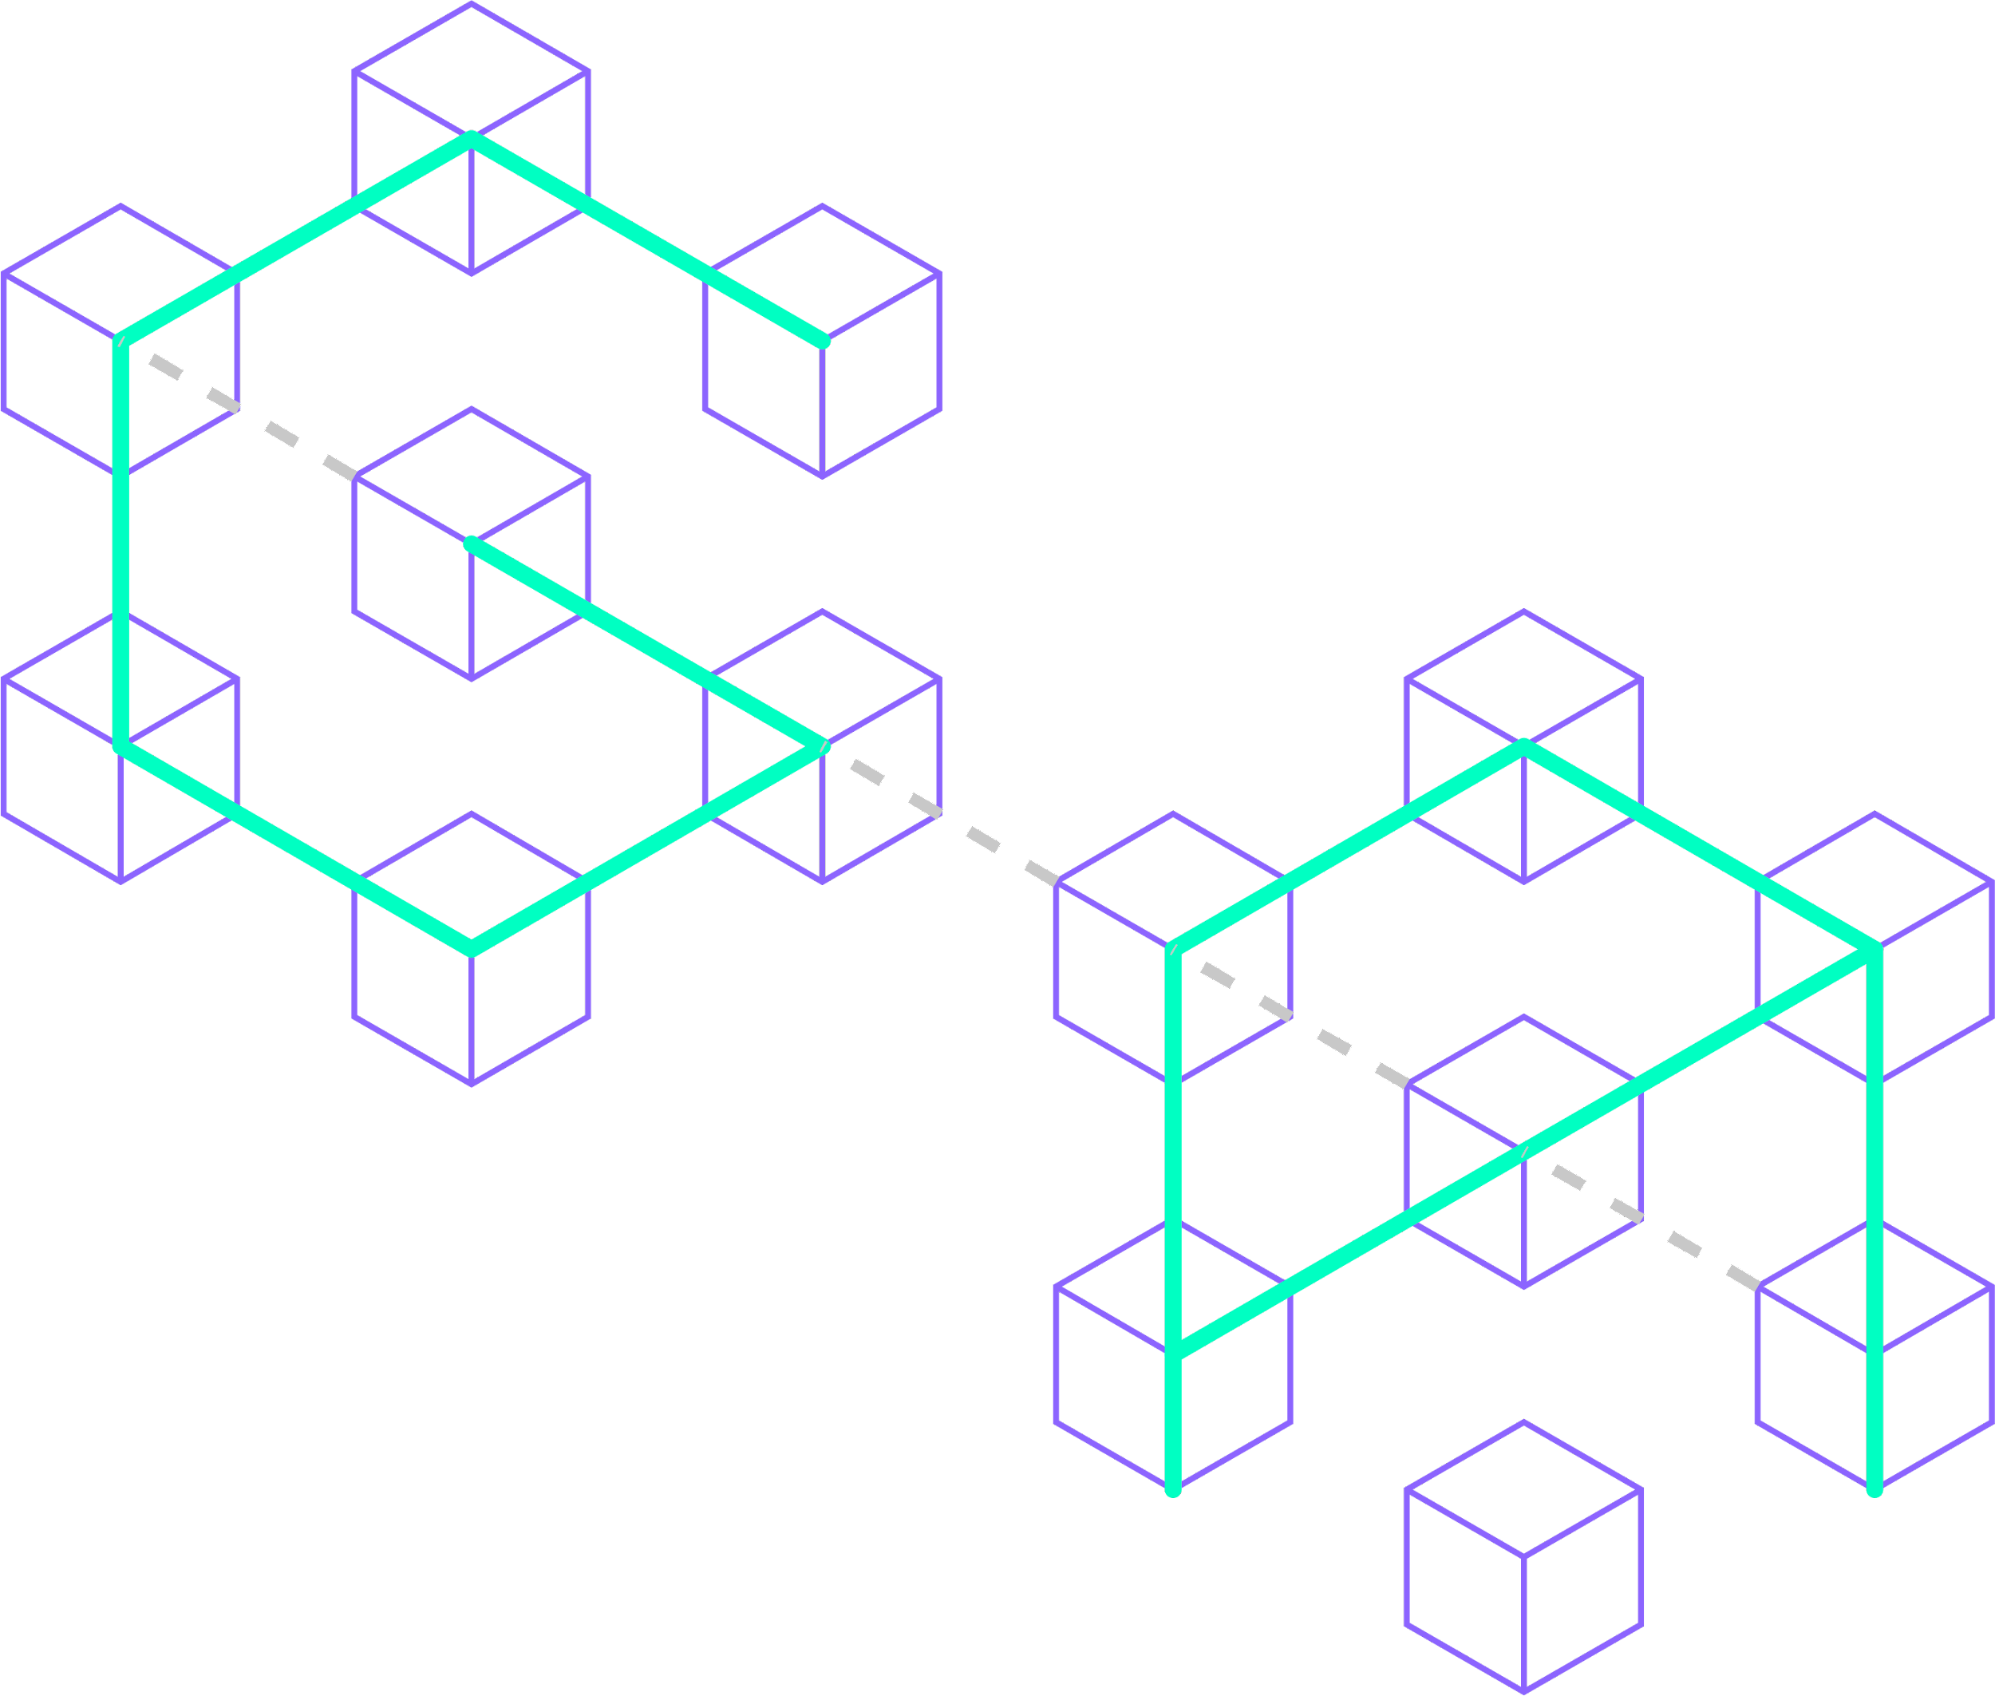



Diving into Metis:
The Unique Layer 2 Solution for True Decentralization

Slide 2
Heading 1
Heading 2
Source:
Date as of May 23, 2023
Note:
Twitter: @GryphsisAcademy

Slide 3
Radiant Team
Core Team | George·Tom·Aaron·Liam·Roger
Dev Ops | Marcel-Front End Developer Steve-Front End Developer Daniel-Smart Contract Engineer Roy-SmartContracts/BackEnd JD-Junior Developer
Director of Communications | Isaac Prada
DAO Admin | Hung Vu
Support Staff | Konstantin·Ed·HungVu·Dodge·Masterexit·0xStorm
Source: Gryphsis Academy
Date as of May 31, 2023
Twitter: @GryphsisAcademy

Slide 4
Radiant Team
Core Team | Dev Ops | Communications | Support | Business Development | DAO Admin
Aaron | Daniel | Isaac Prada | Dodge | Konstantin | Hung Vu
George | JD |  | Ed | 0xStorm
Liam | Marcel |  | Hung Vu
Roger | Roy |  | Konstantin
Tom | Steve |  | 0xStorm
Source: Gryphsis Academy
Date as of May 31, 2023

Slide 5
并行EVM叙事主要项目
项目 | 成立时间 | 类型 | 有无代币 | 价格 | 流通市值 | 24H交易量 | 融资轮次 | 融资金额
Solana | 2017 | L1 | 有 | $103.55 | $450亿 | $22亿 | 私募代币销售轮 | $3.14亿
Aptos | 2021 | L1 | 有 | $9.12 | $33亿 | $1.6亿 | 战略融资 | 未披露
Sei v2 | 2022 | L1 | 有 | $0.85 | $21亿 | $3.9亿 | 战略融资 | 未披露
Sui | 2022 | L1 | 有 | $1.67 | $19亿 | $3.5亿 | B轮 | $3亿
Neon | 2021 | L2 | 有 | $1.20 | $6900万 | $290万 | 公募轮 | $500万
Monad | 2022 | L1 | 无 | / | / | / | 种子轮 | $1900万
Eclipse | 2022 | L2 | 无 | / | / | / | 种子轮 | $900万
Fuel | 2019 | 其他 | 无 | / | / | / | 战略融资 | $8000万
Lumio | 2023 | L2 | 无 | / | / | / | / | /
Source: CoinMarketCap, RootData
Date as of February 22, 2024

Slide 6
并行EVM技术实现路径
项目 | 架构 | 类型 | 虚拟机 | 并行执行方式 | 开发语言 | 特点
Solana | 单体 | L1 | SVM | Memory locks
Aptos | 单体 | L1 | MoveVM | Block-STM
Sei v2 | 单体 | L1 | SeiVM | Block-STM |  | 双虚拟机支持
Sui | 单体 | L1 | MoveVM | Memory locks
Neon | 单体 | L2 | EVM模拟器 | /
Monad | 单体 | L1 | 兼容EVM | Block-STM
Eclipse | 单体 | L2 | 依托SVM | /
Fuel | 模块化 | 其他 | FuelVM
Lumio | 单体 | L2 | 依托MoveVM/SVM | / |  | 多虚拟机支持
Source: CoinMarketCap, RootData
Date as of February 22, 2024

Slide 7
以太坊与并行L1公链主要生态
项目 | TPS | 生态项目数量 | DeFi | NFT | 游戏 | 元宇宙 | 基础设施
以太坊 | 12.8 | 2256 | 805 | 366 | 141 | 37 | 371
Solana | 3191 | 561 | 151 | 70 | 66 | 13 | 111
Aptos | 17 | 157 | 56 | 22 | 5 | 1 | 39
Sei v2 | 28300* | 62 | 32 | 1 | 2 | 0 | 17
Sui | 46 | 99 | 42 | 12 | 6 | 0 | 24
Monad | 10000* | 2 | 2 | 0 | 0 | 0 | 0
Source: EtherScan, Solana Explorer, Aptos Explorer, Sei Blog, Monad Homepage, RootData
Note: TPS theoretical value marked with *
Date as of February 24, 2024

Slide 8
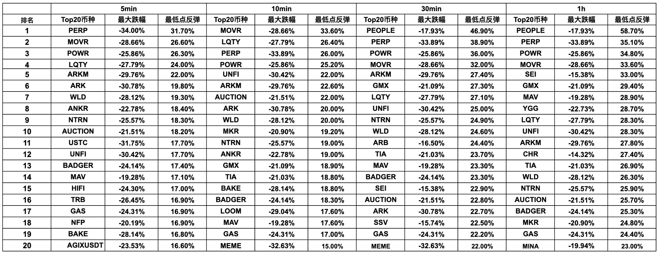
山寨插针反弹表现
Binance 交易所现货 USDT 交易对
Source: Binance
Date as of Jan 3, 2024
Twitter: @GryphsisAcademy

Slide 9
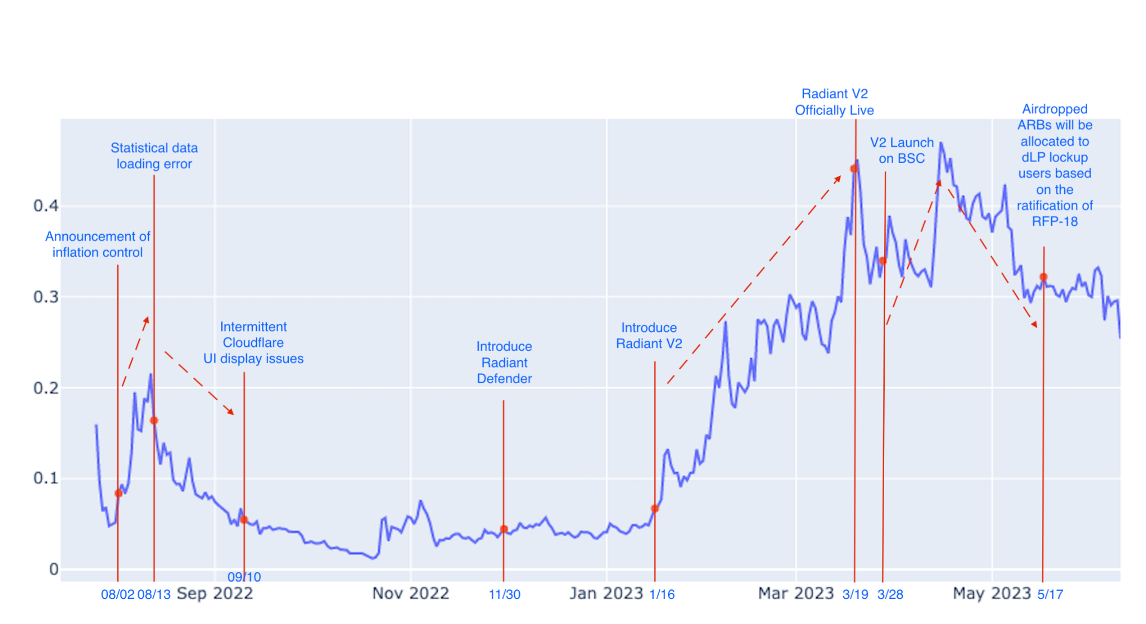
RDNT Price & Historical Events
Date as of May 31, 2023
Source: Coin Marketcap, Gryphsis Academy
Twitter: @GryphsisAcademy

Slide 10
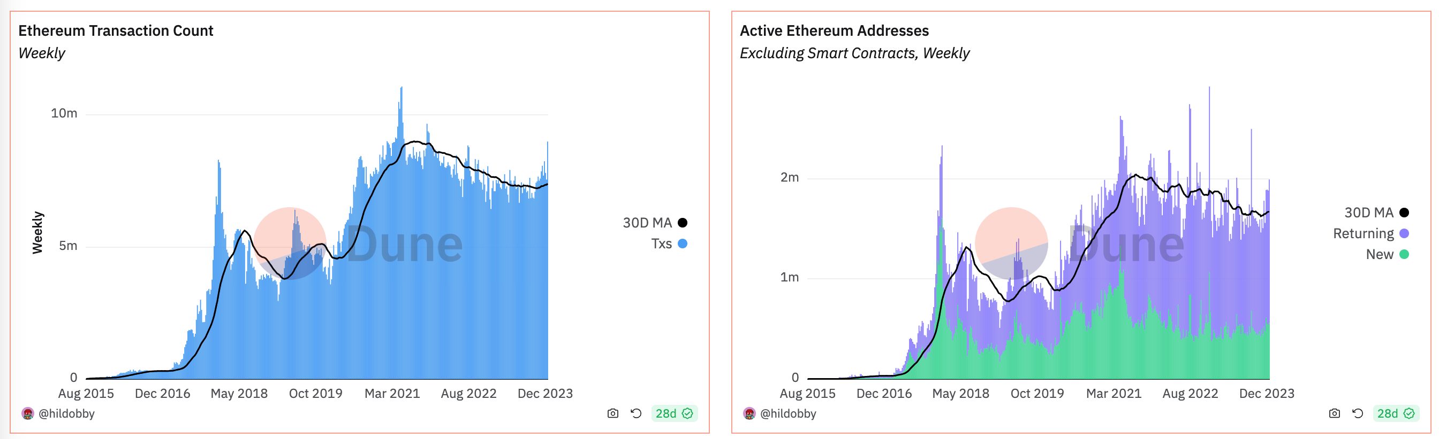
以太坊交易数量和活跃地址
Source: Dune @hildobby, ethereum
Date as of Feb 22, 2024
Twitter: @GryphsisAcademy

Slide 11
并行EVM与以太坊生态、L1生态流通市值和交易量对比
流通市值：
13.4%
86.6%
24H交易量：
9%
91%
并行EVM
以太坊
流通市值：
9.1%
90.9%
24H交易量：
10.8%
89.2%
并行L1
L1生态
Source: CoinMarketCap
Date as of Feb 22, 2024
Twitter: @GryphsisAcademy

Slide 12
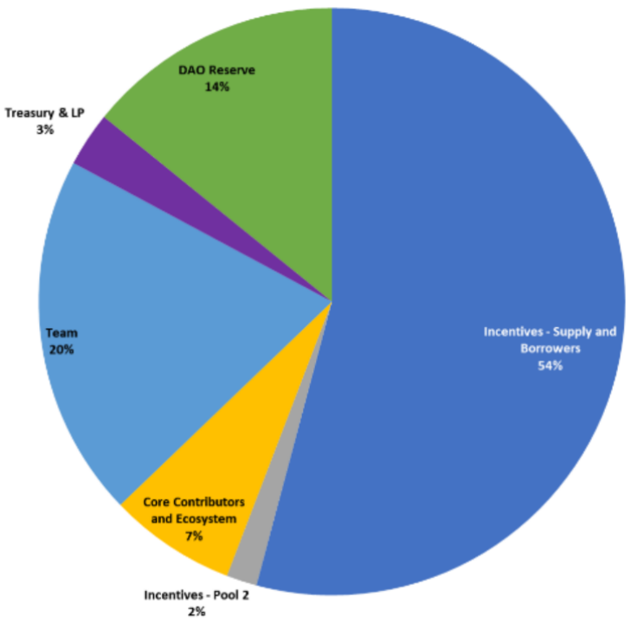
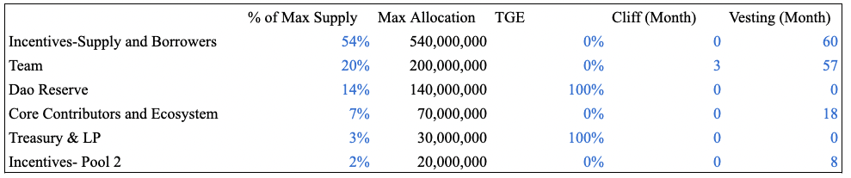
Token Allocation
Source: https://docs.radiant.capital/radiant/project-info/rdnt-tokenomics
Date as of May 31, 2023
Twitter: @GryphsisAcademy

Slide 13
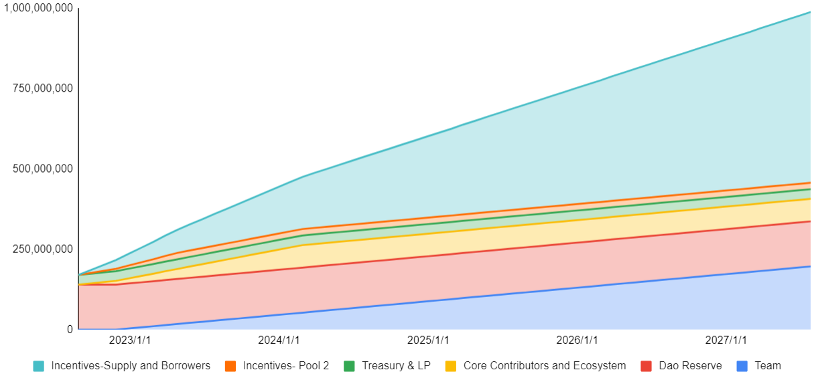
Release Schedule
Source: Gryphsis Academy
Date as of May 31, 2023
Twitter: @GryphsisAcademy

Slide 14
Radiant Lending Market Assets
 | Arbitrum | BSC
Stablecoins | DAI | BUSD
 | USDC | USDC
 | USDT | USDT
BTC/ETH | ETH | ETH
 | WBTC | BTCB
 | WSTETH
Alt L1/L2 | ARB | BNB
Source: Gryphsis Academy
Date as of May 31, 2023
Twitter: @GryphsisAcademy

Slide 15
Business Development Progress
Partners | Details
Stargate | Layer Zero / Stargate have cooperated with Radiant on many fronts since launch, including peer-reviewing Radiant’s smart contracts. Per Stargate’s snapshot proposal, the RDNT token will be supported as a bridgeable asset via their OFT bridge
Lido Finance | Radiant Capital will support wstETH as part of the v2 deployment, and Lido will participate in a dual incentives program.
Balancer | Radiant recently launched v2 in partnership with Balancer as part of the plans to expand RDNT liquidity. Within 24 hours, the RDNT-WETH pool became the largest Balancer pool on Arbitrum.
Chainlink | Radiant has relied on Chainlink oracles since inception for all collateral assets on Arbitrum and will continue expanding Chainlink oracle support in the Omnichain vision.
Arrakis & Gamma Strategies | Radiant is partnering with Arrakis and Gamma Strategies per on-chain governance vote in order to expand multi-chain protocol owned liquidity.
Source: Gryphsis Academy
Date as of May 31, 2023
Twitter: @GryphsisAcademy

Slide 16
Radiant Development Roadmap
Version | Roadmap
V1.0 | Fork of AAVE with Stargate expanding omnichain vision. Implementation and Real Yield. Solely on Arbitrum.
V2.0 | LaverZero OFT implementation.Can scale to every EVM chain. Emissions extended to 2027. Dozens of new assets are to be supported as collateral.
V3.0 | Forego STG for full LayerZero implementation. Continue expanding omnichain vision.
V4.0 | Become the “LayerZero'' for liquidity &yield. Help onboard the next 100 million users for crypto.
Source: Gryphsis Academy
Date as of May 31, 2023
Twitter: @GryphsisAcademy

Slide 17
Completed Milestones
Season | Milestones
2022 Q3 | Radiant Capital Fair Launches on Arbitrum
 | Radiant grows to top TVL project on Arbitrum
2022 Q4 | Unveil Radiant’s framework for DAO-based governance and the Radiant Foundation Proposal (RFP)
 | Dynamic Liquidity Providers Achieve $5M in Fees
2023 Q1 | Become the first Price/Fees Ratio Project in DeFi per TokenTerminal
 | Launch of Radiant v2
Source: Gryphsis Academy
Date as of May 31, 2023
Twitter: @GryphsisAcademy

Slide 18
Current Roadmap
Season | Milestones
Q2 2023 | 1. Dual-emissions and expanded Oracle support
 | 2. Collateral expansion
 | 3. Ethereum Mainnet Deployment
Q3 2023 | 1. Deployment on more chains
 | 2. Cross-Chain liquidations
 | 3. Abstracted repayments → repay on any chain
 | 4. Full LayerZero Messaging support
Q4 2023 | Radiant Synthetics
Source: Gryphsis Academy
Date as of May 31, 2023
Twitter: @GryphsisAcademy

Slide 19
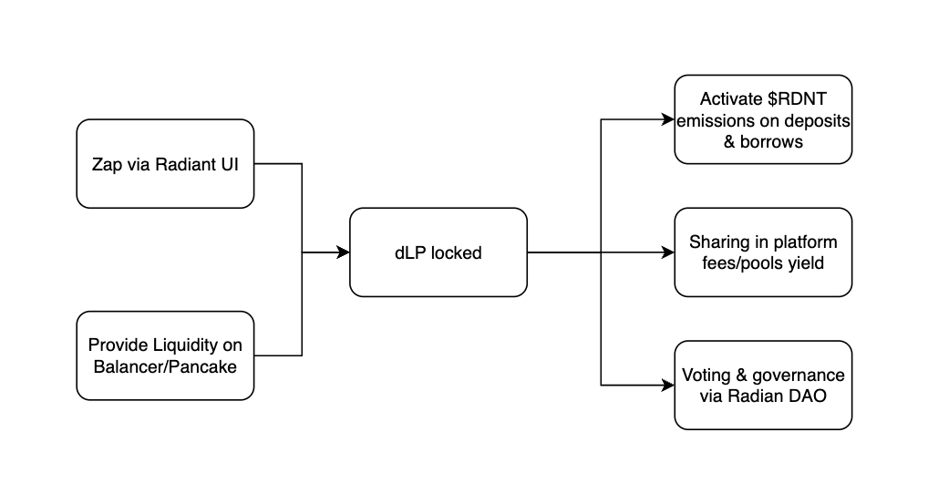
dLP Function Chart
Source: Gryphsis Academy
Date as of May 31, 2023
Twitter: @GryphsisAcademy

Slide 20

















Fuel生态一览
DeFi
NFT
基础设施
Source: RootData
Date as of Feb 25, 2024
Twitter: @GryphsisAcademy

Slide 21
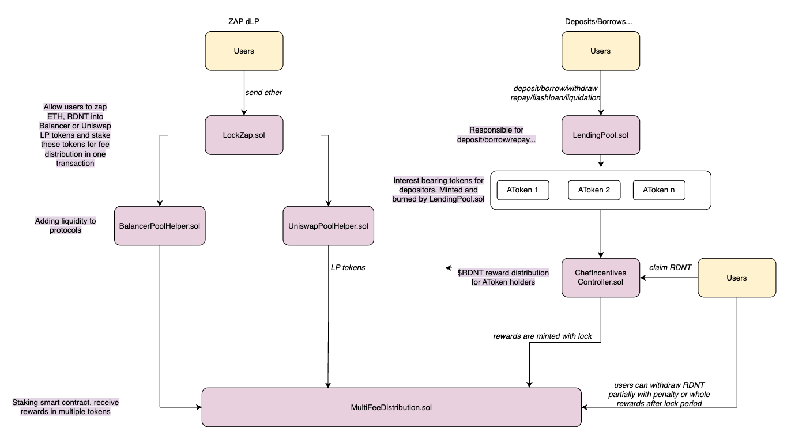
Business Logic Code Implementation
Source: Gryphsis Academy
Date as of May 31, 2023
Twitter: @GryphsisAcademy

Slide 22
虚拟机工作原理
智能合约代码（Solidity/Rust/Go...）
opcode/wasm/ebpf字节码
opcode/wasm/eBPF虚拟机
X86
ARM
MIPS
...
Source: Gryphsis Academy
Date as of Mar 1, 2024
Twitter: @GryphsisAcademy

Slide 23
Actor模型
Actor1
state
message
message
Actor1
Actor1
message
state
state
Source: Gryphsis Academy
Date as of Mar 1, 2024
Twitter: @GryphsisAcademy

Slide 24
Memory locks模型
任务2
等待
等待
lock();
read_and_update();
unlock();
任务3
共享资源
任务1
等待
任务4
Source: Gryphsis Academy
Date as of Mar 1, 2024
Twitter: @GryphsisAcademy

Slide 25
死锁-活锁-饥饿
任务2处于活跃状态？主动让出！
任务1
优先级高
任务1
任务1已获取资源A，需要资源B
共享资源A
任务1
任务2
共享资源
共享资源
共享资源B
任务2已获取资源B，需要资源A
任务1处于活跃状态？主动让出！
任务2
任务3
任务2
优先级低
死锁
活锁
饥饿
Source: Gryphsis Academy
Date as of Mar 1, 2024
Twitter: @GryphsisAcademy

Slide 26
乐观并行化
共享资源A
共享资源B
任务1
任务2
任务3
任务4
任务5
任务6
任务7
任务8
Execution 1：
任务1
A
任务3
B
任务4
B
任务7
A
Execution 2：
任务2
B
任务4
B
任务6
A
任务8
B
Execution 3
任务3
B
任务5
A
任务7
A
Stage1
Stage2
Stage3
Stage4
Source: Gryphsis Academy
Date as of Mar 2, 2024
Twitter: @GryphsisAcademy

Slide 27
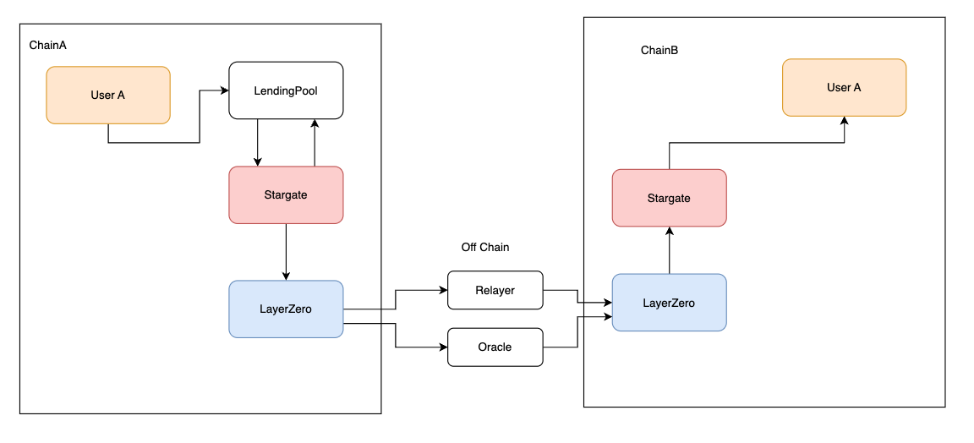
LayerZero/Stargate Integration Flow Chart
Source: Gryphsis Academy
Date as of May 31, 2023
Twitter: @GryphsisAcademy

Slide 28
Radiant TVL Ranking
 | Ranking
DeFi | 21
Lending (all chians) | 6
Lending (Arbitrum) | 1
Lending (BSC) | 3
Source: Defillama
Date as of May 31, 2023
Twitter: @GryphsisAcademy

Slide 29
Cross-chain Lending Competitive Space
 | TVL | Status
Radiant | 612.6M | Arbitrum, BSC
AAVE | 9B | Multiple Chains
Lend Hub | 9,291 | Heco
Goledo Finance | 6.4M | Conflux Network
Cedro Finance | Testnet
Prime | Testnet
Tashi | Developing | Evmos
Compound | 2.54B | Multiple Chains
Source: Tokenterminal
Date as of June 14, 2023
Twitter: @GryphsisAcademy
Notes:
radiant tvl - 612.6M
aave – 9 b
compound - 2.54 b
goledo = 6,405,443
lendhub 9,291
defillma 6/14

Slide 30
Token Allocation Version Differences
 | V1 | V2
Lenders and Borrowers | 50% | 70% (+ community)
Pool2 | 20%
Team | 20% | 20%
Advisors & Ecosystem | 7% | 7%
DEX and CEX Liquidity | 3% | 3%
RDNT DAO Reserve |  | No formal allocation
Source: Radiant Capital
Date as of May 31, 2023
Twitter: @GryphsisAcademy

Slide 31
Lending Competitive Space Key Metrics
 | Radiant | Aave | Venus | Compound
TVL | 577.51m | 8.07b | 1.1b | 2.53b
Active Loans (Annualized) | 365.3m | 2660m | 428.93m | 770m
Active Loans/TVL | 63% | 33% | 39% | 30%
MCap (Fully diluted) | 261.66 | 890.76 | 105.85 | 278
Mcap/TVL | 0.45 | 0.11 | 0.10 | 0.11
Revenue Annualized | 11.61 | 12.94 | 2.33 | 3.71
Users 30D (May) | 36.8k | 28.5k | 191.46 | 99.43
TVL | 577.51m | 8.07b | 1.1b | 2.53b
Trading Volume (May) | 740.7m | 1.2b | 93.9m | 141.5m
Source: Tokenterminal
Date as of June 14, 2023
Twitter: @GryphsisAcademy

Slide 32
Radiant v.s. AAVE
Utilization Rate Comparison
 | Radiant | AAVE(on arbitrum)
WBTC | 42.47% | 12.68%
WETH | 55.92% | 48.78%
DAI | 61.82% | 58.52%
USDC | 61.52% | 75.03%
USDT | 62.10% | 78.74%
Source: Dune, aavescan
Date as of May 31, 2023
Twitter: @GryphsisAcademy

Slide 33
Radiant Utilization Rate
 | Monthly Average | Assumption
StabeCoins | 72.48% | 73%
BTC/ETH | 52.7% | 50%
Alt L1/L2 | 57.18% | 50%
Source: Dune
Date as of May 31, 2023
Twitter: @GryphsisAcademy

Slide 34
DCF Analysis - TVL Growth Assumptions
BTC&ETH | Growth Rate 2024 | Growth Rate 2028 | BTC/Gold 2028 | ETH/Microsoft 2028
Low | 20% | 15% | 5% | 7%
Moderate | 30% | 20% | 7% | 9%
High | 40% | 25% | 9% | 13%
Stabe Coins | Growth Rate 2024 | Growth Rate 2028 | Stabecoins/Gold 2028
Low | 15% | 10% | 18%
Moderate | 20% | 15% | 18%
High | 30% | 20% | 20%
Alt L1/L2 | Growth Rate 2024 | Growth Rate 2028 | Alt L1&L2/ETH 2028
Low | 50% | 30% | 0.05%
Moderate | 80% | 40% | 0.11%
High | 120% | 50% | 0.21%
Source: Gryphsis Academy
Date as of May 31, 2023
Twitter: @GryphsisAcademy

Slide 35
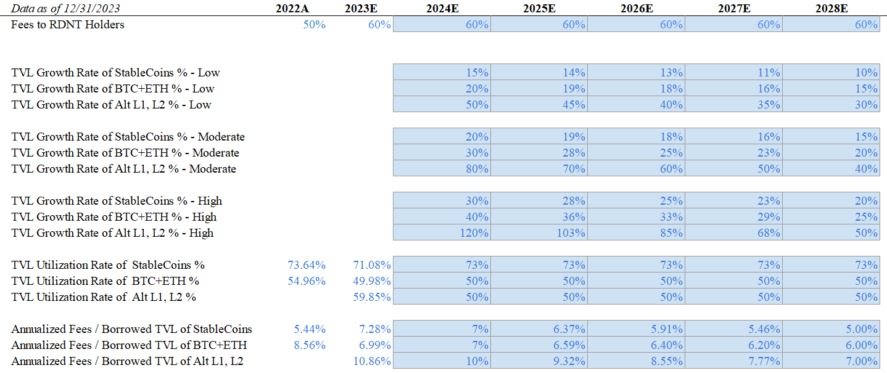
DCF Analysis - Assumptions
Source: Gryphsis Academy
Date as of Dec 31, 2023
Twitter: @GryphsisAcademy

Slide 36
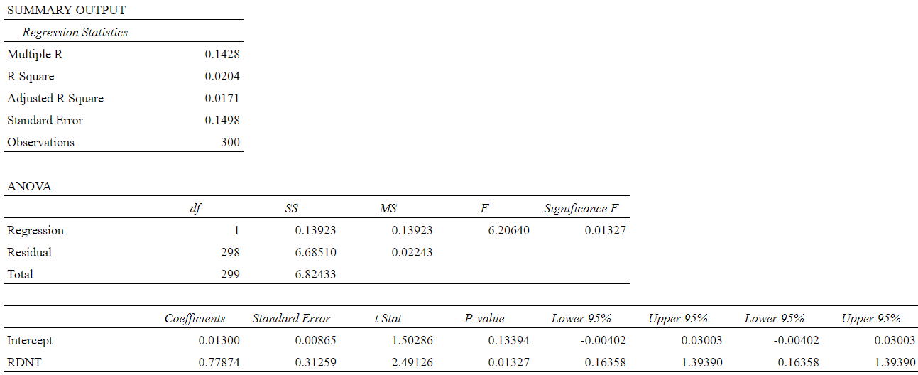
Regression Output
Source: Gryphsis Academy
Date as of May 20, 2023
Twitter: @GryphsisAcademy

Slide 37
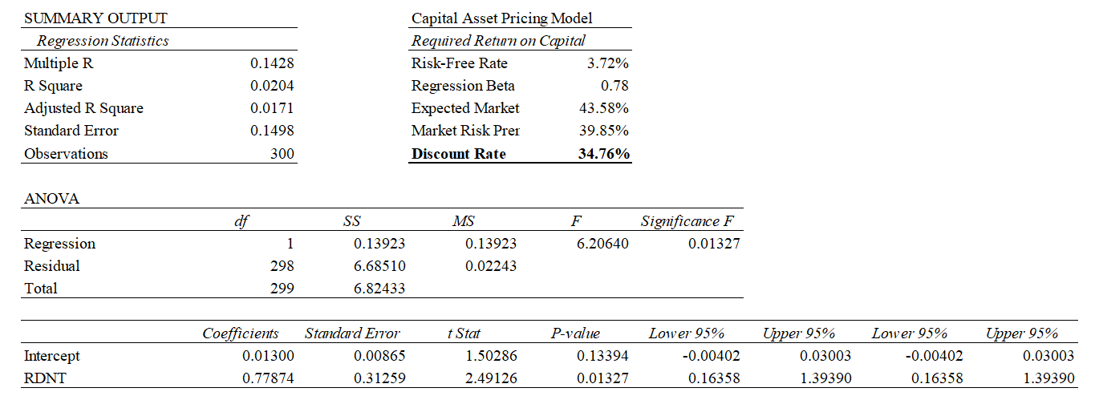
Regression Output
Discount Rate
Source: Gryphsis Academy
Date as of May 20, 2023
Twitter: @GryphsisAcademy

Slide 38
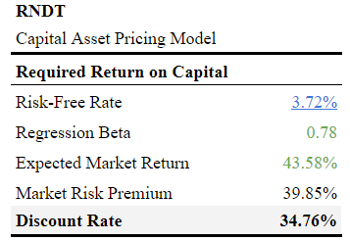
Rate of Return
Source: Gryphsis Academy
Date as of May 20, 2023
Twitter: @GryphsisAcademy

Slide 39
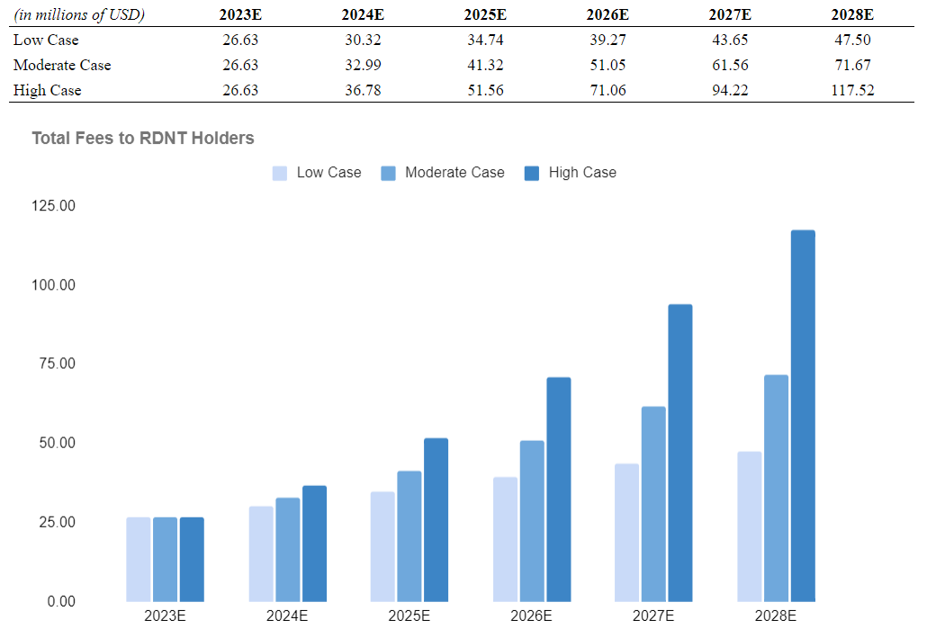
Radiant Total Fees Projection
Source: Gryphsis Academy
Date as of Dec 31, 2023
Twitter: @GryphsisAcademy

Slide 40
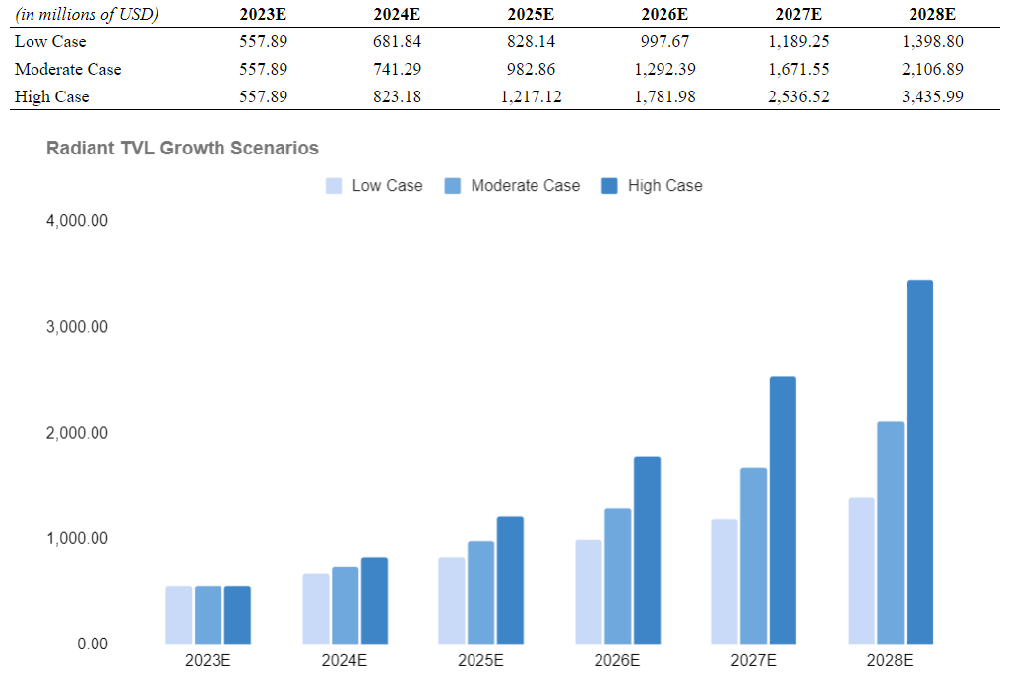
Radiant TVL Projection
Source: Gryphsis Academy
Date as of Dec 31, 2023
Twitter: @GryphsisAcademy

Slide 41
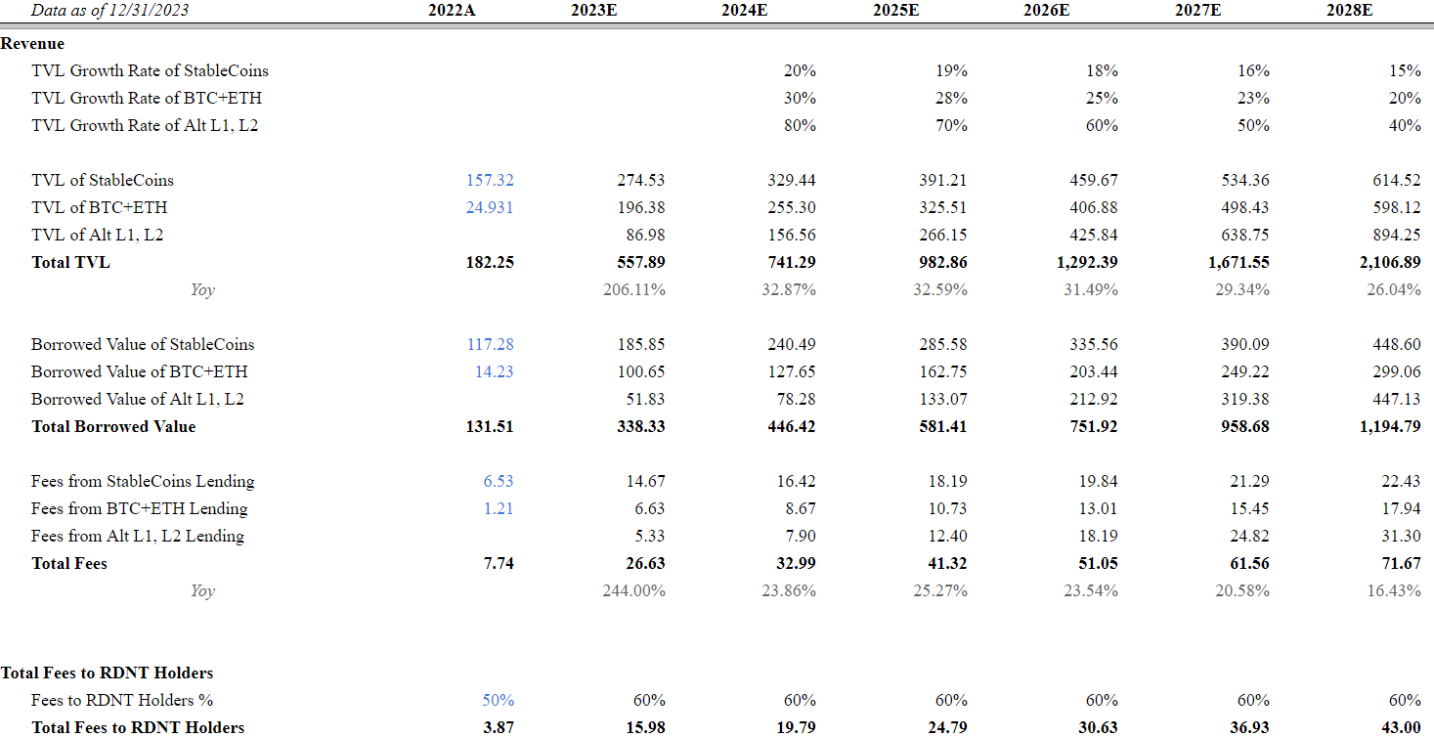
DCF Analysis - Moderate Case
Source: Gryphsis Academy
Date as of Dec 31, 2023
Twitter: @GryphsisAcademy

Slide 42
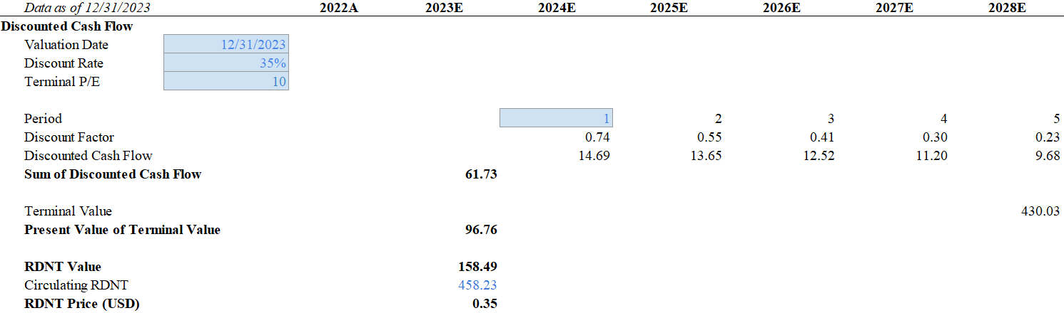
DCF Analysis - Moderate Case
Source: Gryphsis Academy
Date as of Dec 31, 2023
Twitter: @GryphsisAcademy

Slide 43
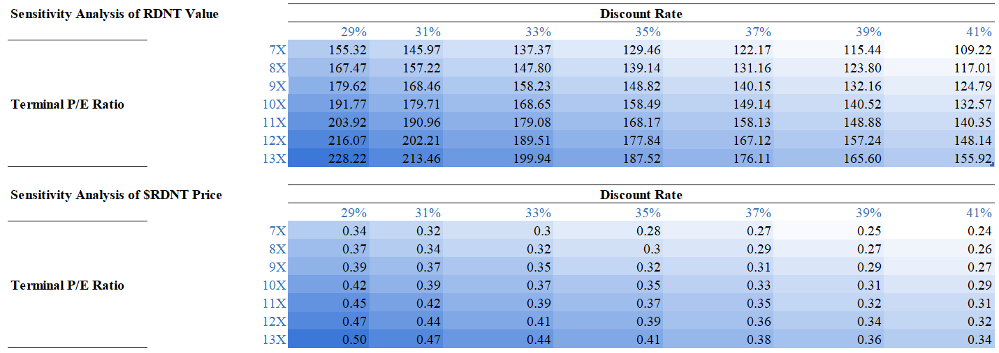
Sensitivity Analysis of RDNT Value & Price
Source: Gryphsis Academy
Date as of Dec 31, 2023
Twitter: @GryphsisAcademy

Slide 44
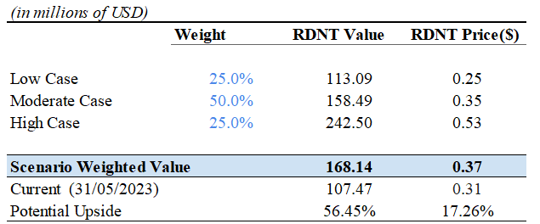
Probability-Weighted DCF Analysis
Source: Gryphsis Academy
Date as of Dec 31, 2023
Twitter: @GryphsisAcademy

Slide 45
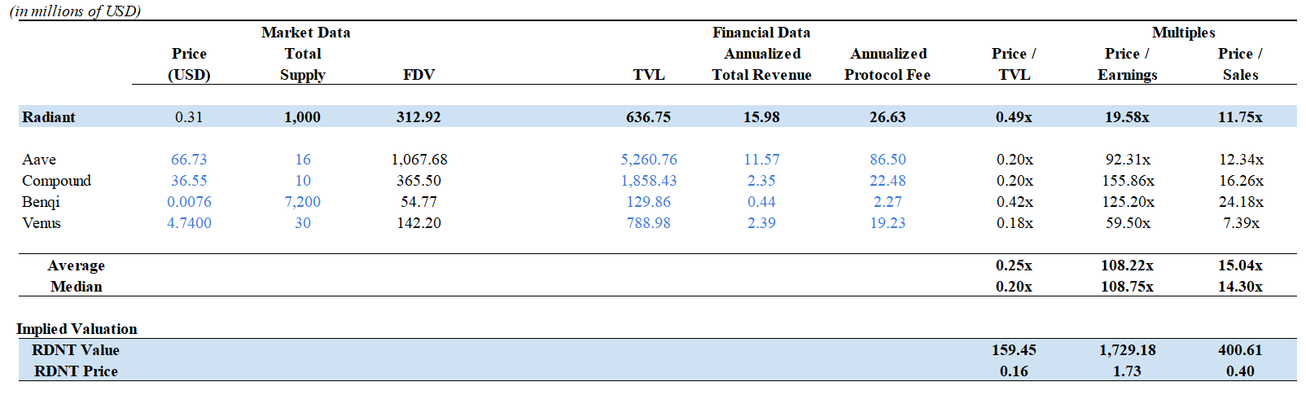
Comparable Analysis
Source: Gryphsis Academy
Date as of May 31, 2023
Twitter: @GryphsisAcademy

Slide 46
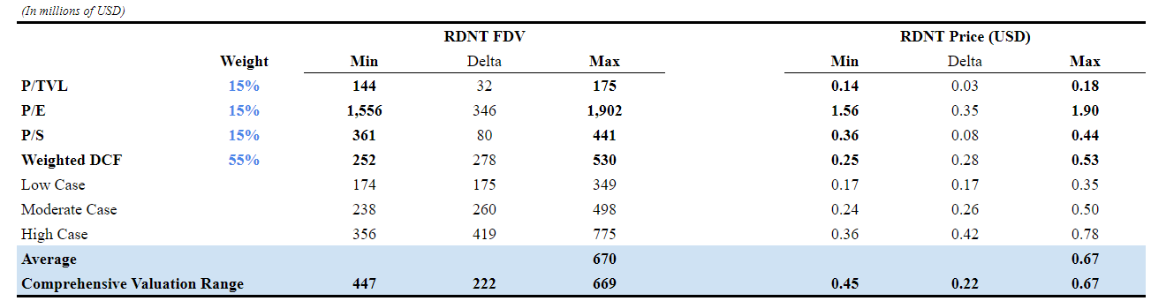
Comprehensive Analysis
Source: Gryphsis Academy
Date as of Dec 31, 2023
Twitter: @GryphsisAcademy

